Slide 1
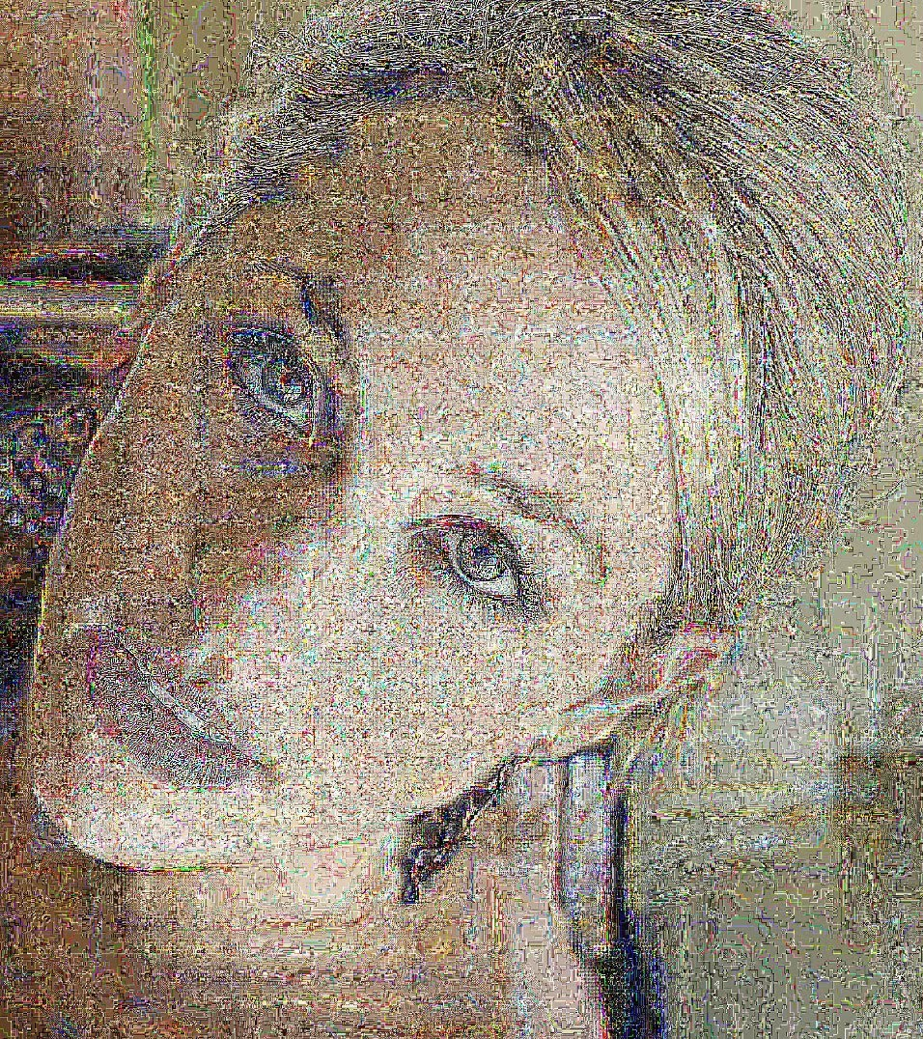

Image Processing
By: Clarity…

Slide 2
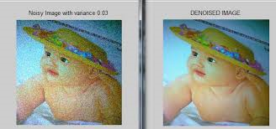
De-noising an Image
Taking a “Noisy” image and removing the noise for a clearer image

Slide 3

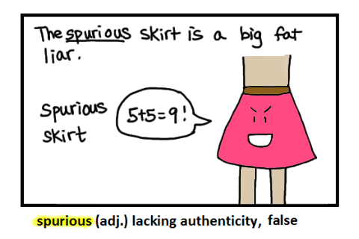
Definition of image noise
Image noise is an undesirable by-product of image capture that adds spurious and extraneous information
Irrelevant data

Slide 4
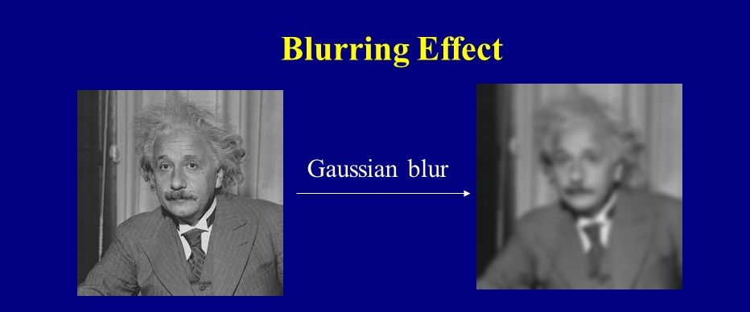
Solutions?
Blurring

Slide 5
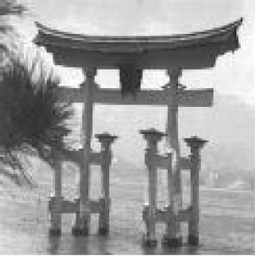
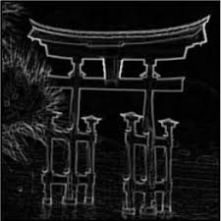
Edge detection
Noisy Image
Noisy Image with edge detection

Slide 6
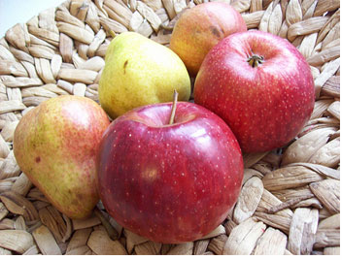
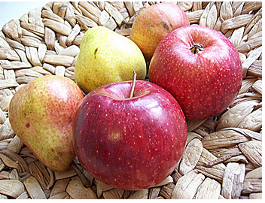
Sharpening
Unsharpened
Sharpened
Darken the darker pixels , brighten the brighter pixels

